Slide 1
Online Banking Application

Slide 2
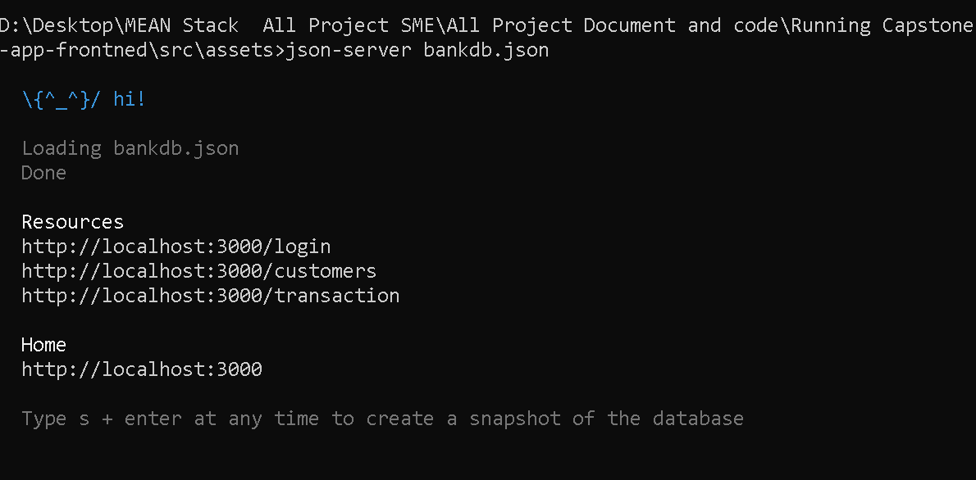
First run the json file using json-server node module
bankdb.json : this file present inside the assets folder.

Slide 3
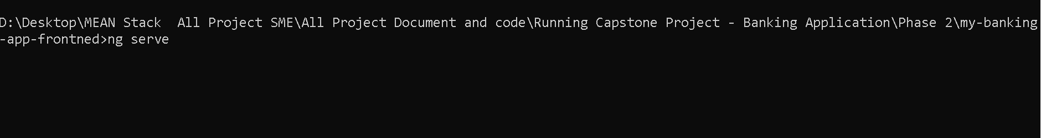
Run the angular project
Ng serve (project name is my-banking-app-frontend)

Slide 4
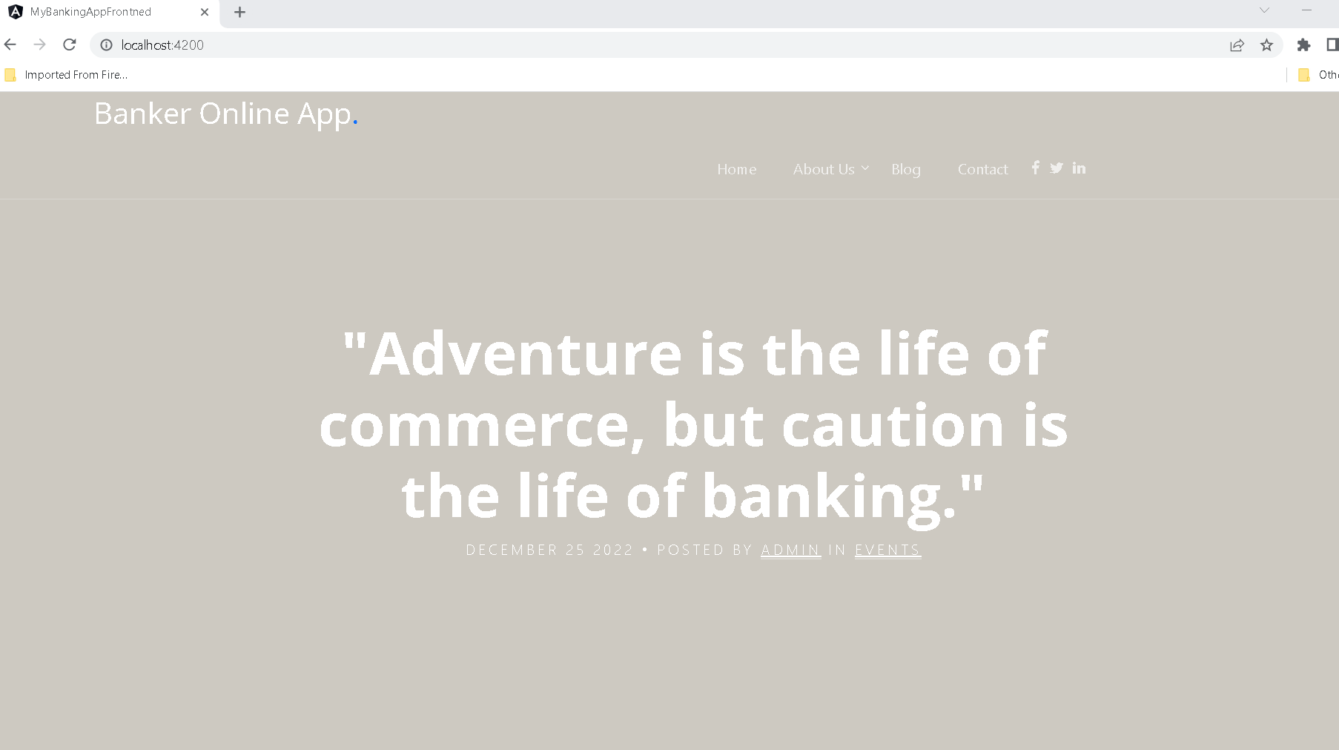
Online banking application landing page

Slide 5
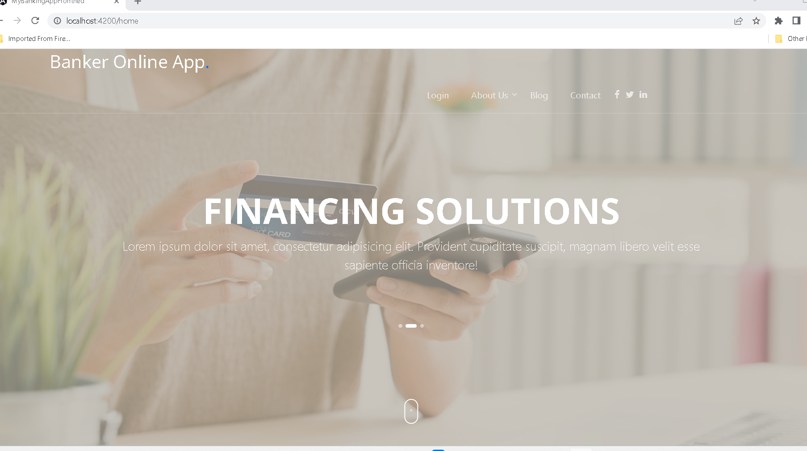
After click home link

Slide 6
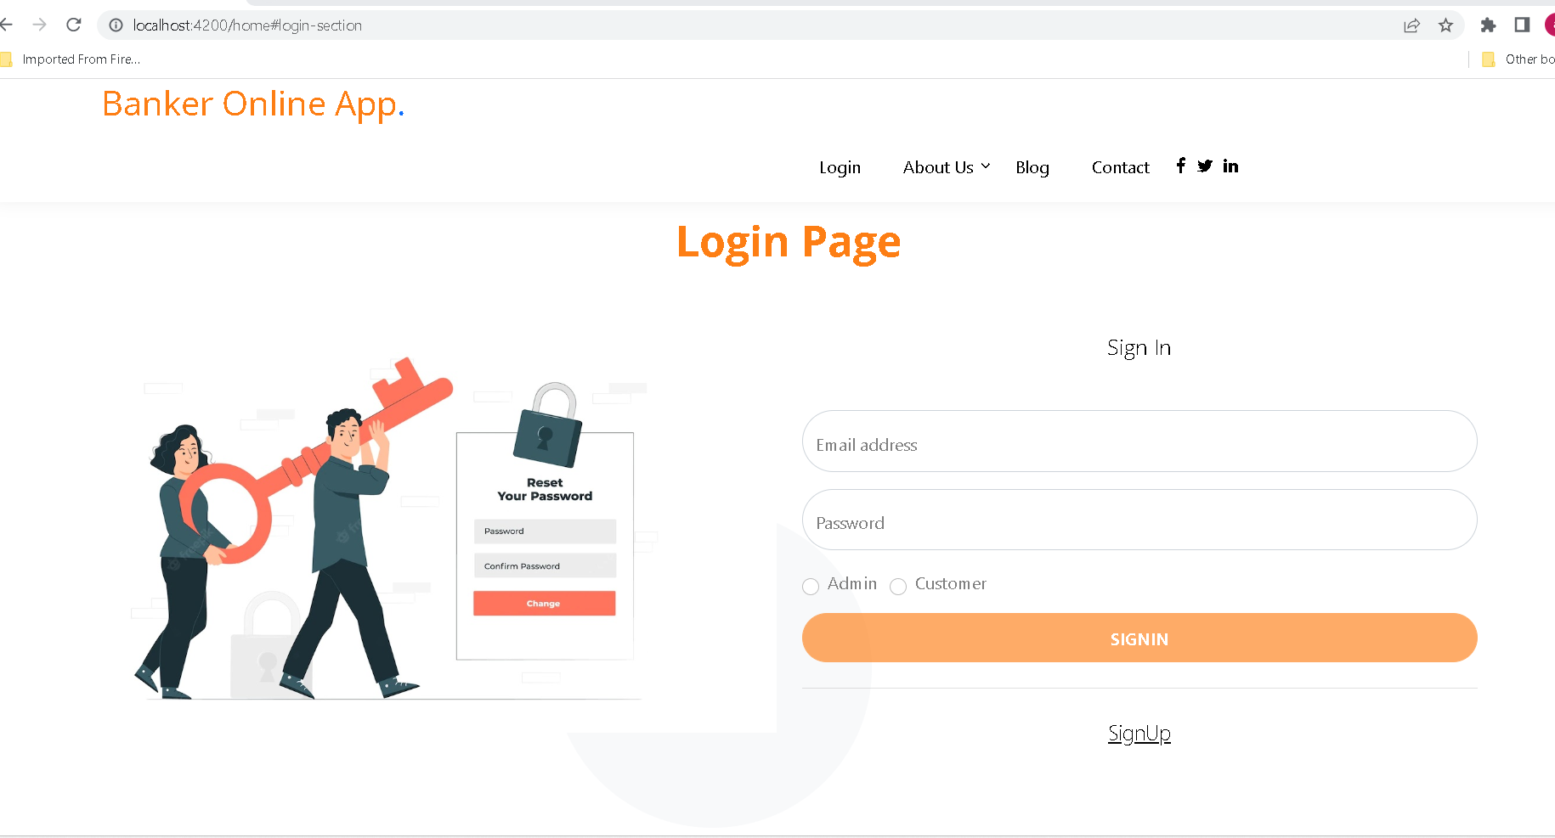
After click on login

Slide 7
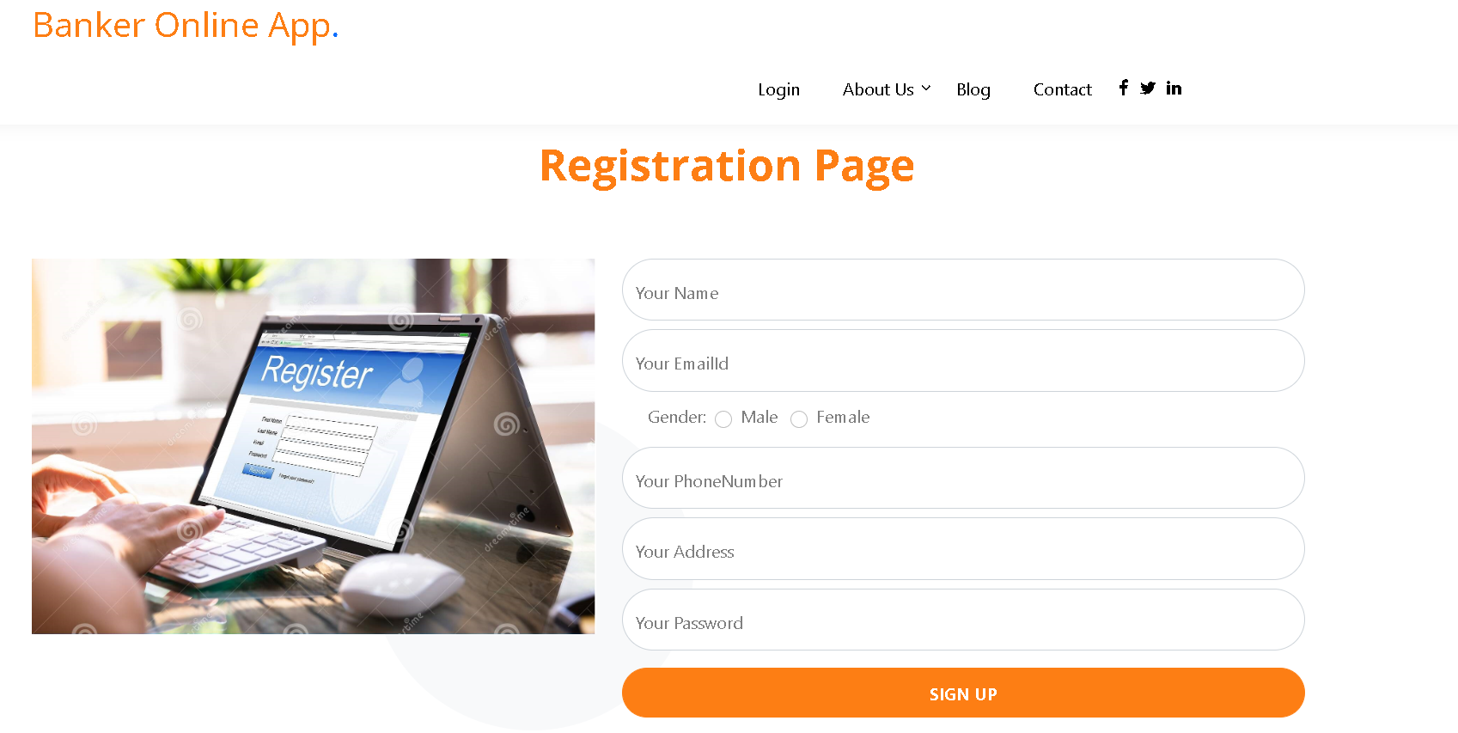
Now we will create the customer account. So click on signup

Slide 8
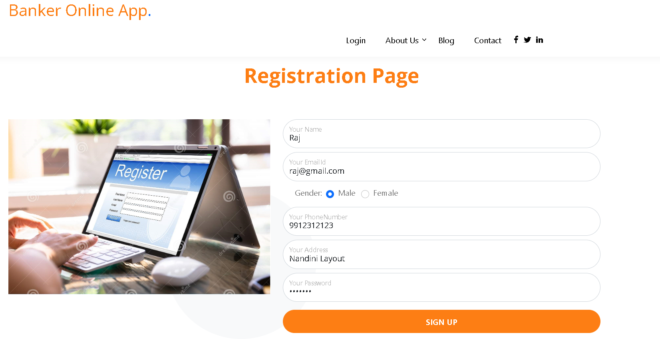
After fill the details

Slide 9
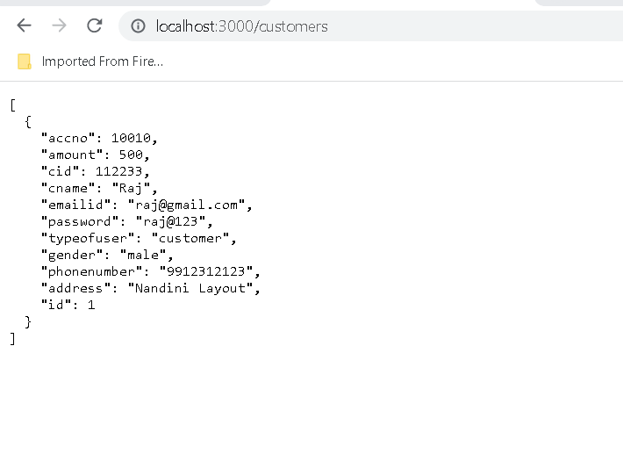
Customer details stored in json file

Slide 10
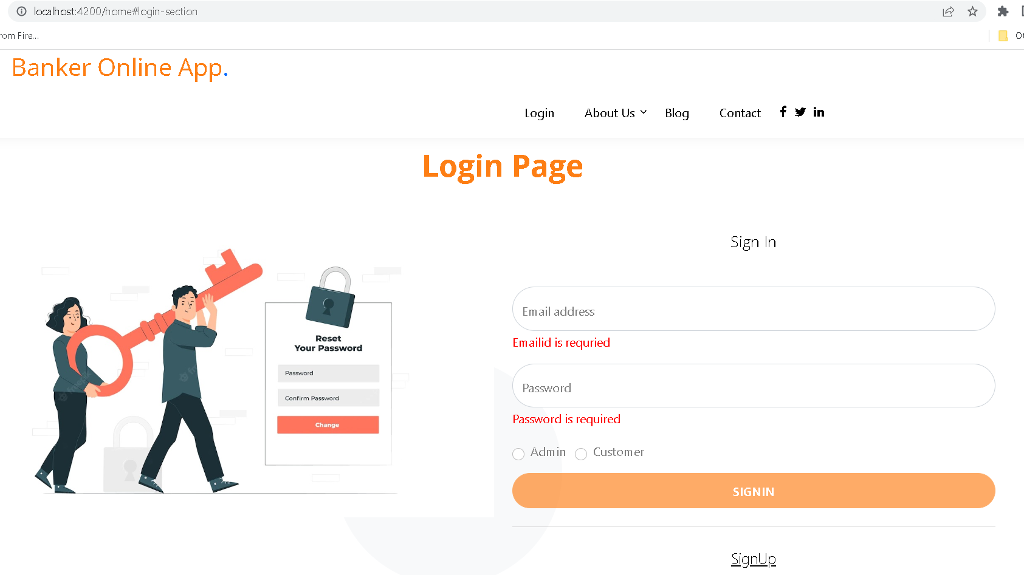
After created account now we can do login

Slide 11
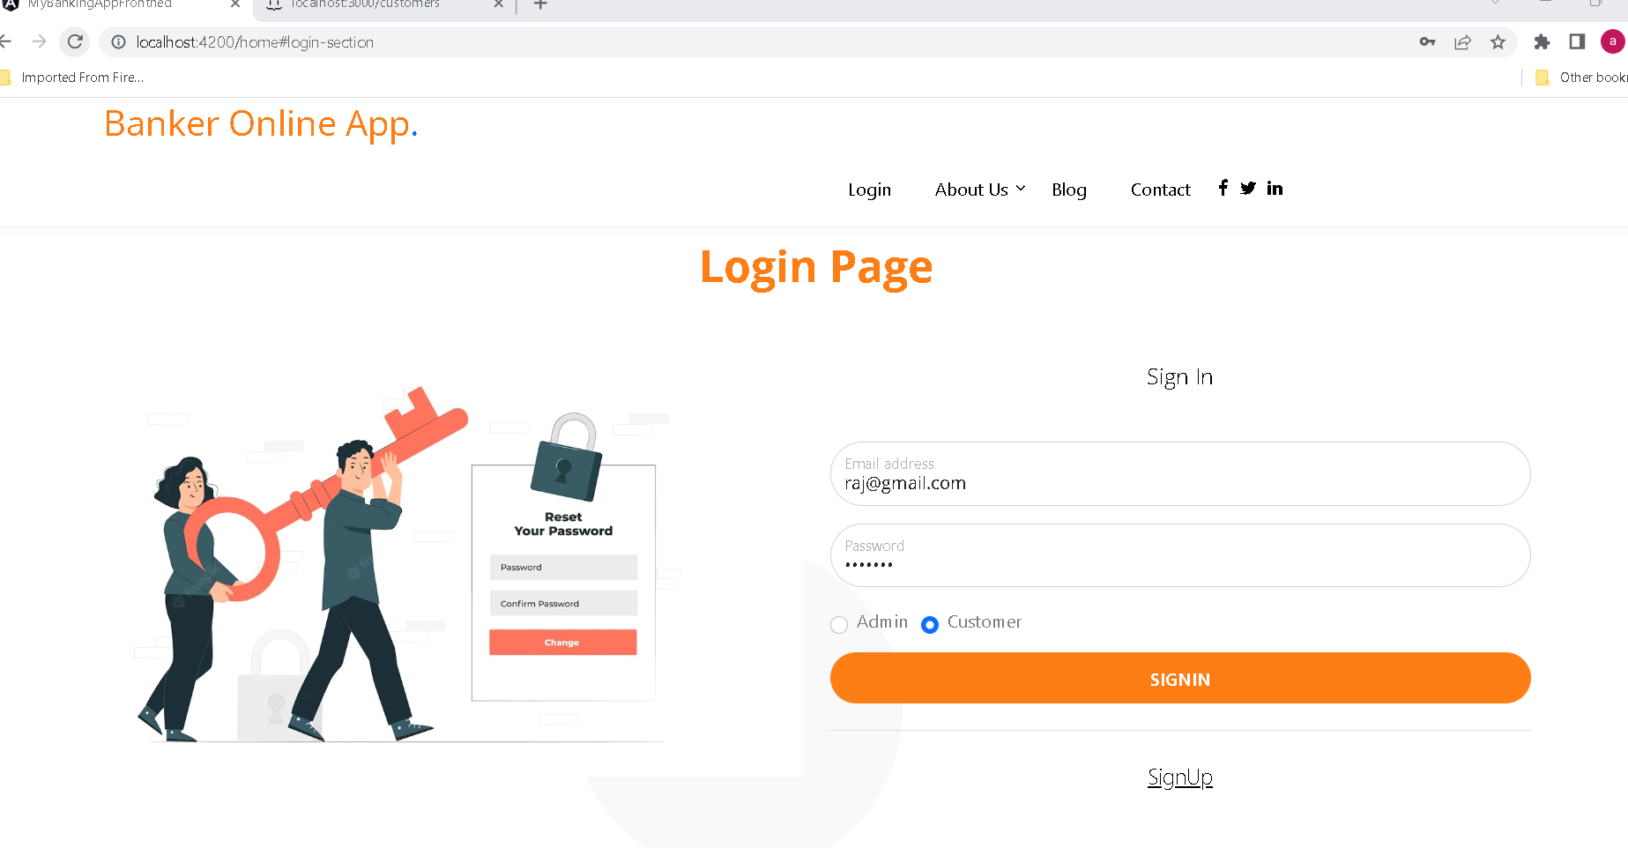
After fill customer login details

Slide 12
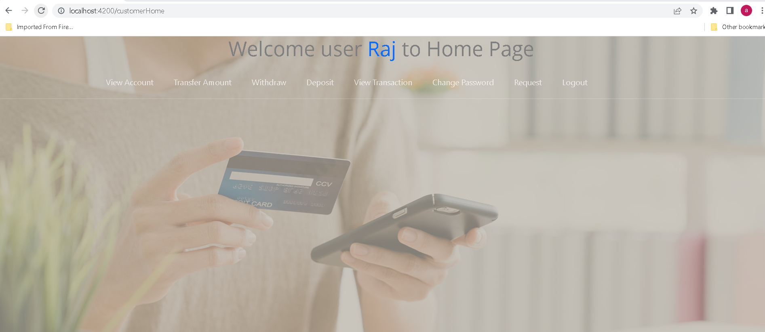
Customer home page

Slide 13
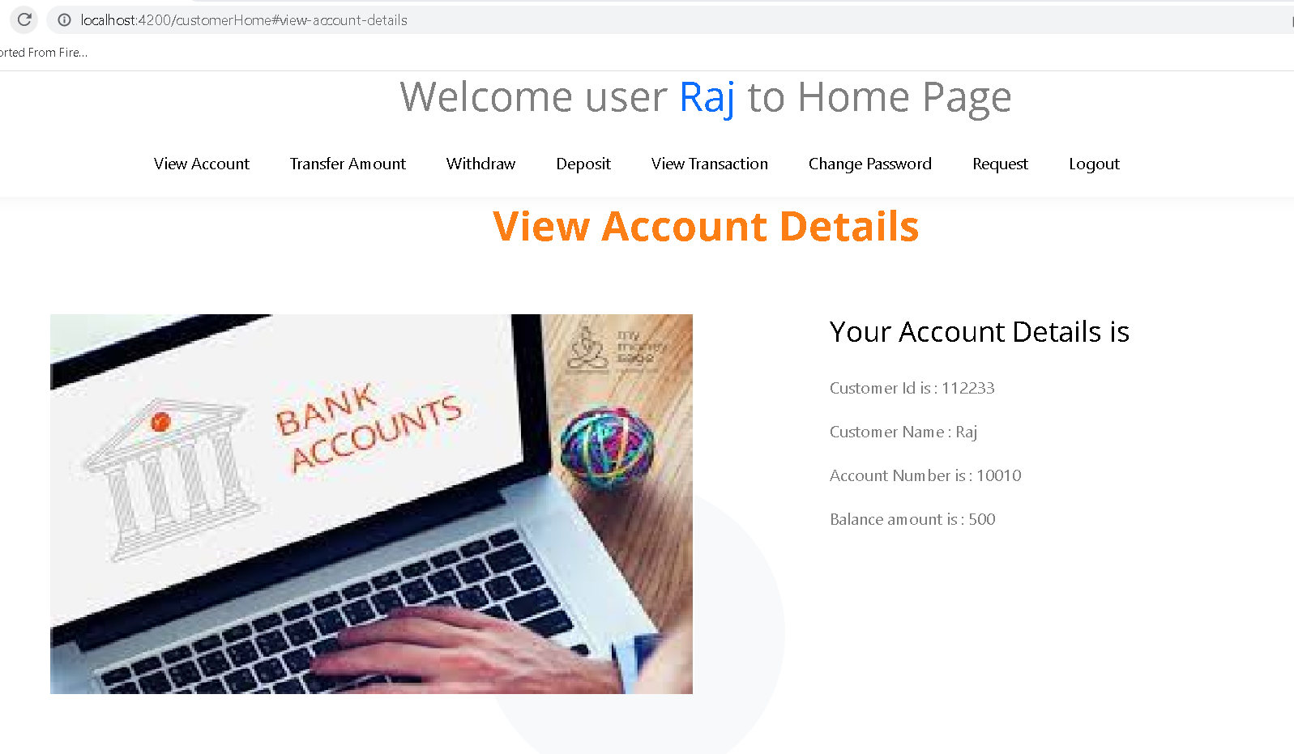
Customer account details – View account

Slide 14
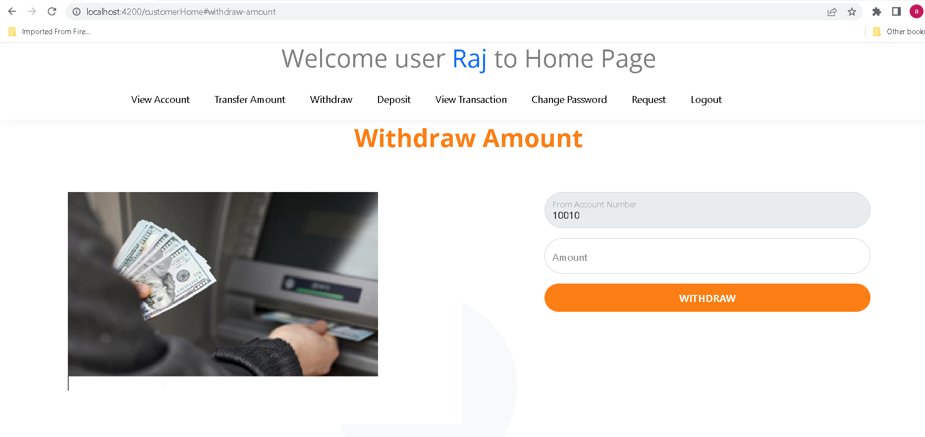
Withdraw amount

Slide 15
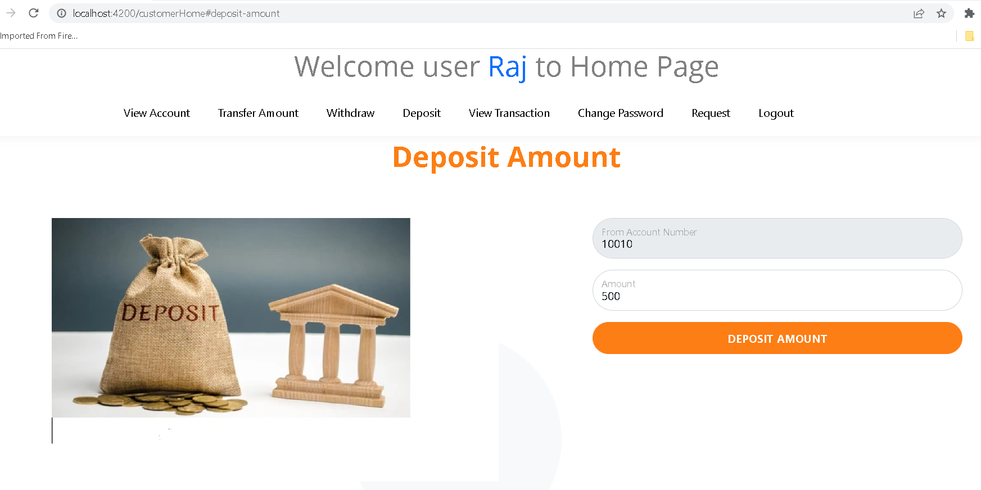
Deposit amount

Slide 16
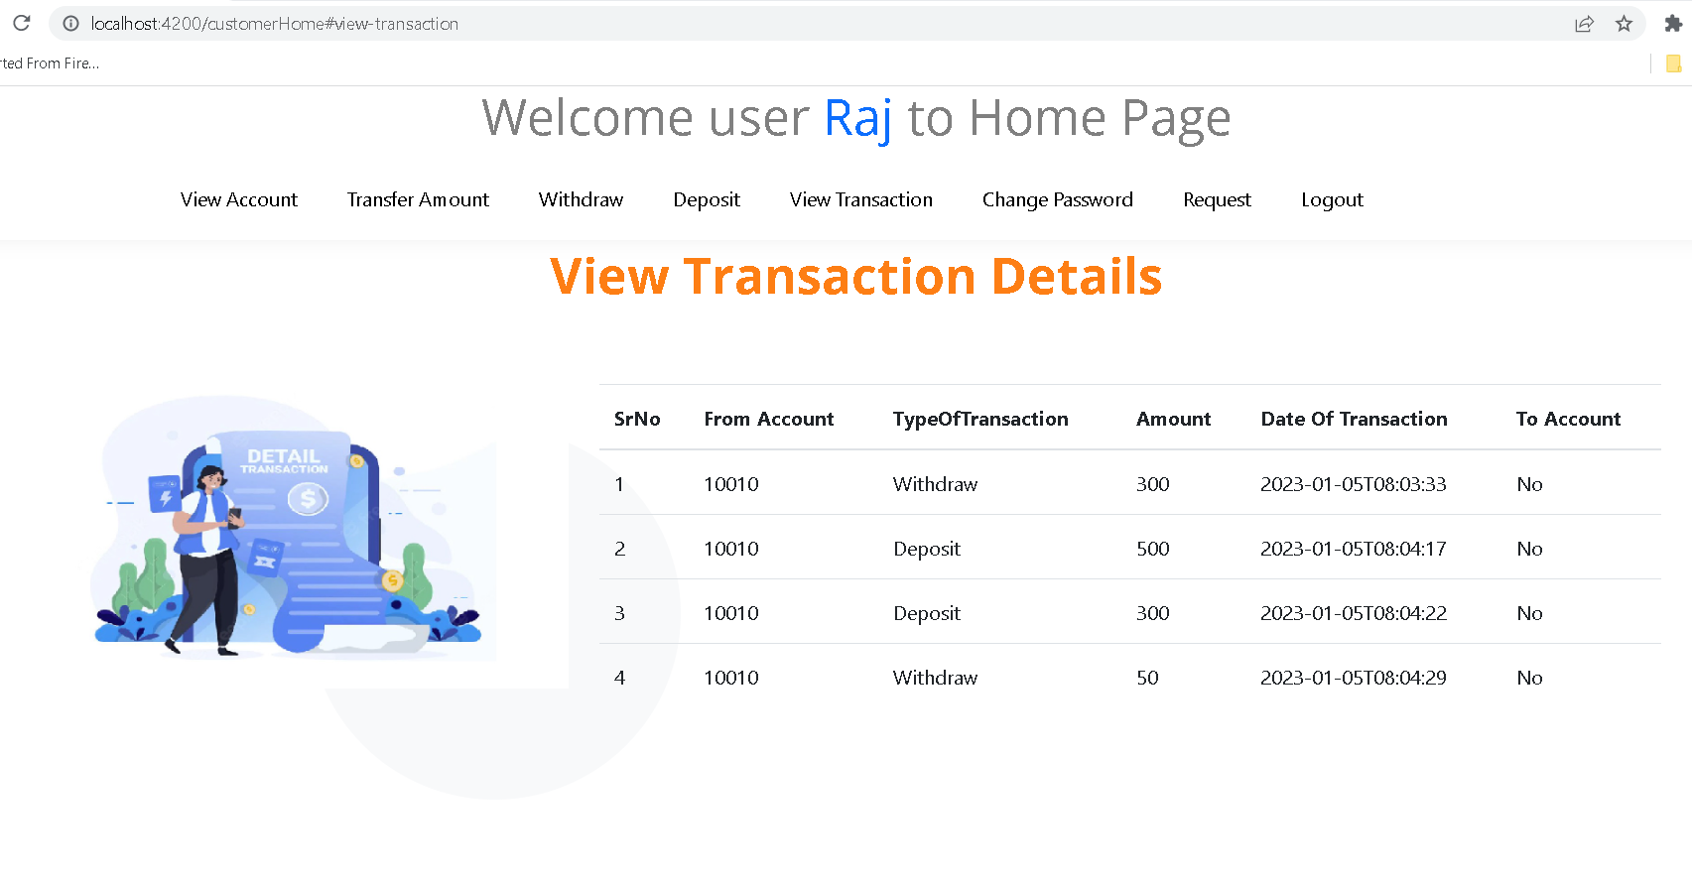
View its own transaction details

Slide 17
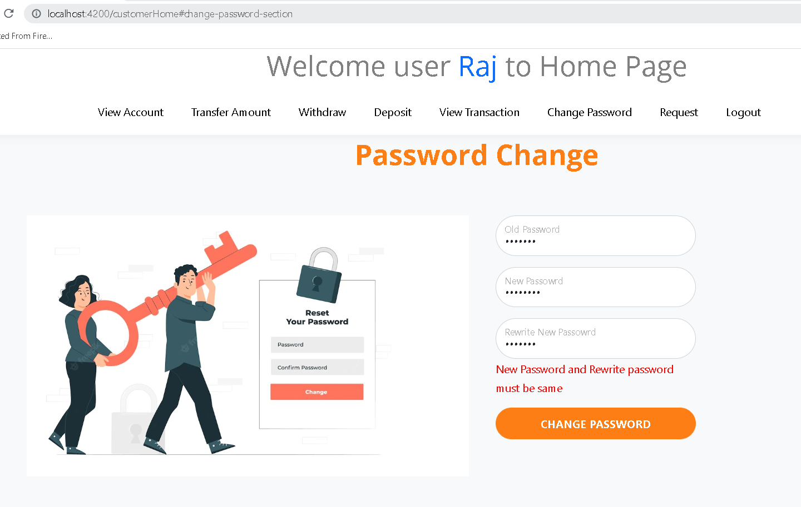
Customer change password

Slide 18
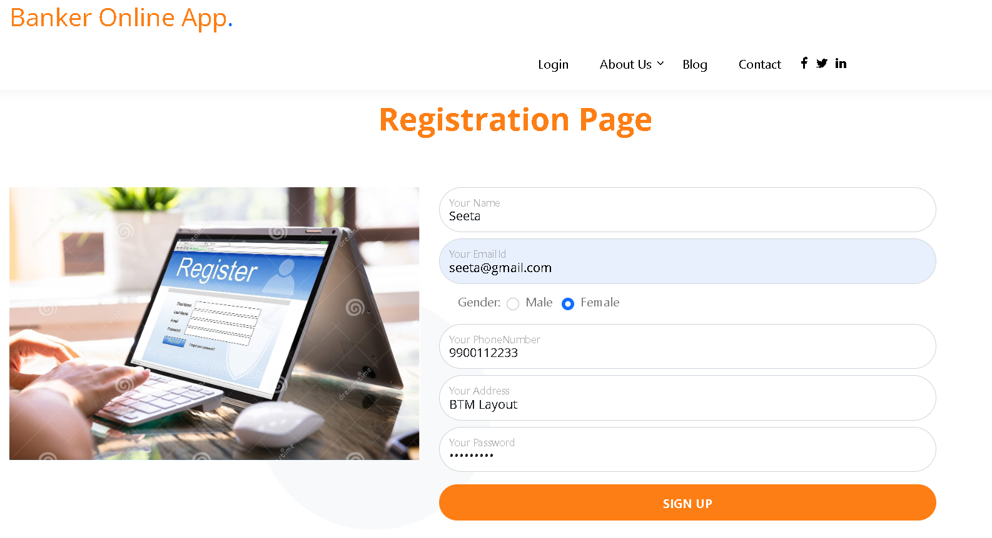
We will create more than one account

Slide 19
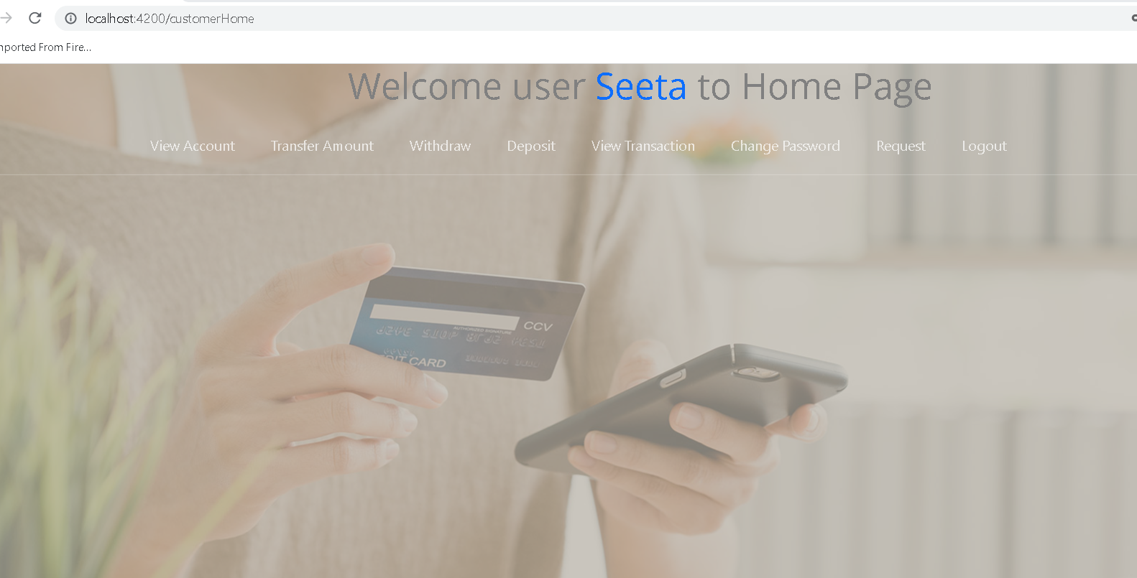
Login with another account

Slide 20
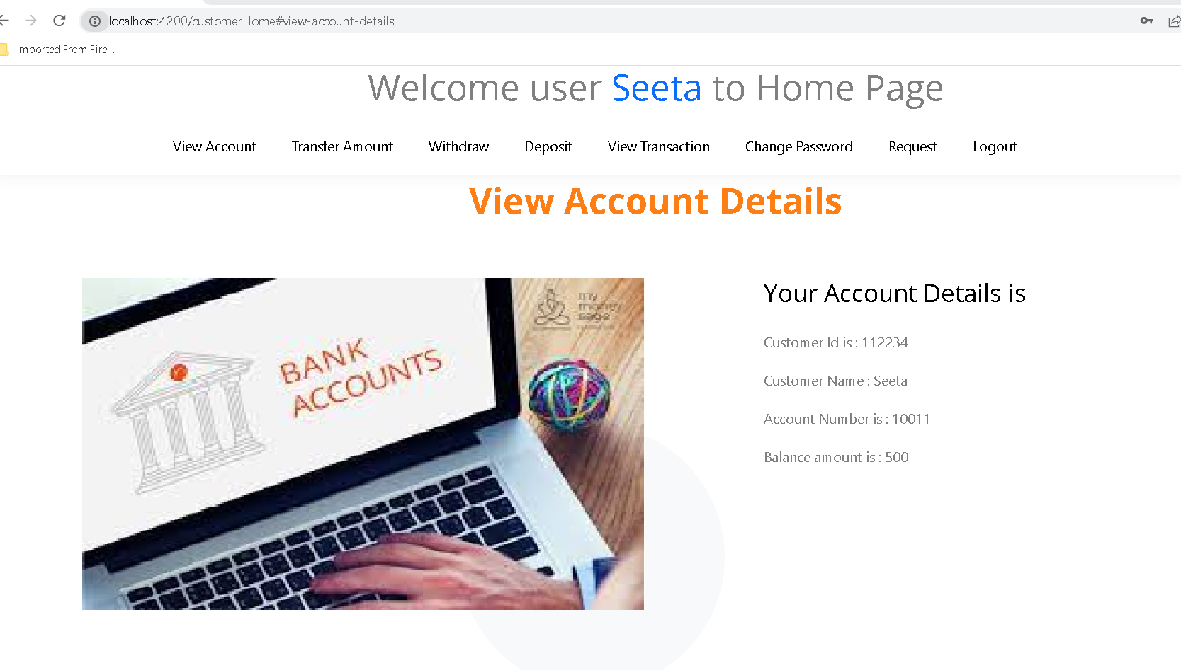
View its own details

Slide 21
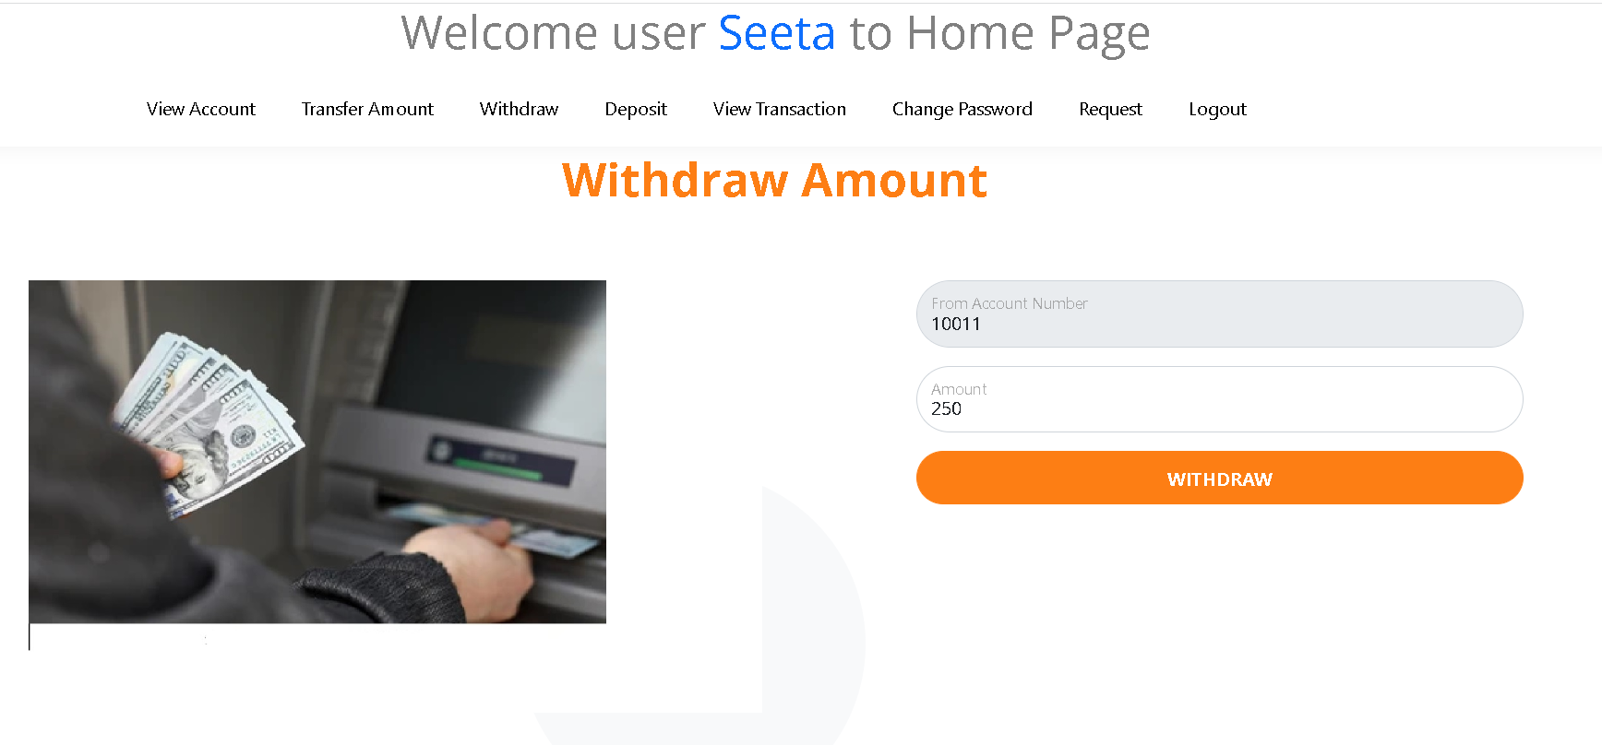
Do more withdraw and deposit operation

Slide 22
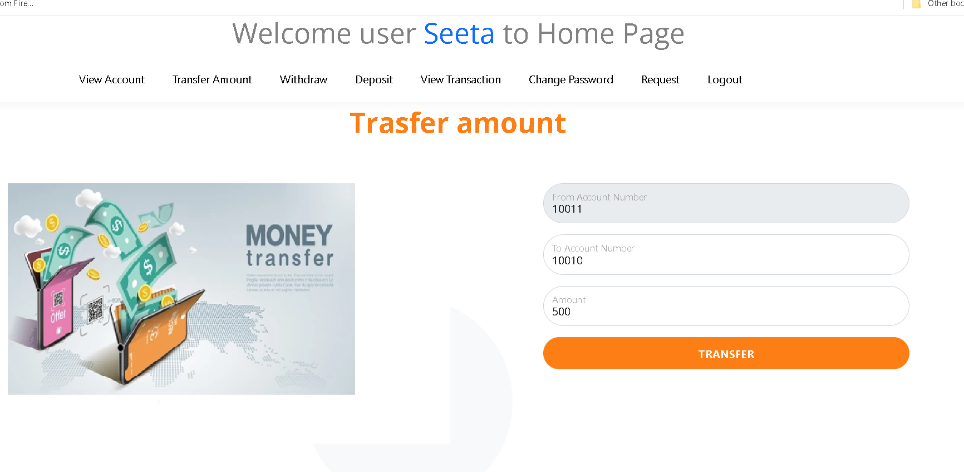
Transfer the amount from one account to another account

Slide 23
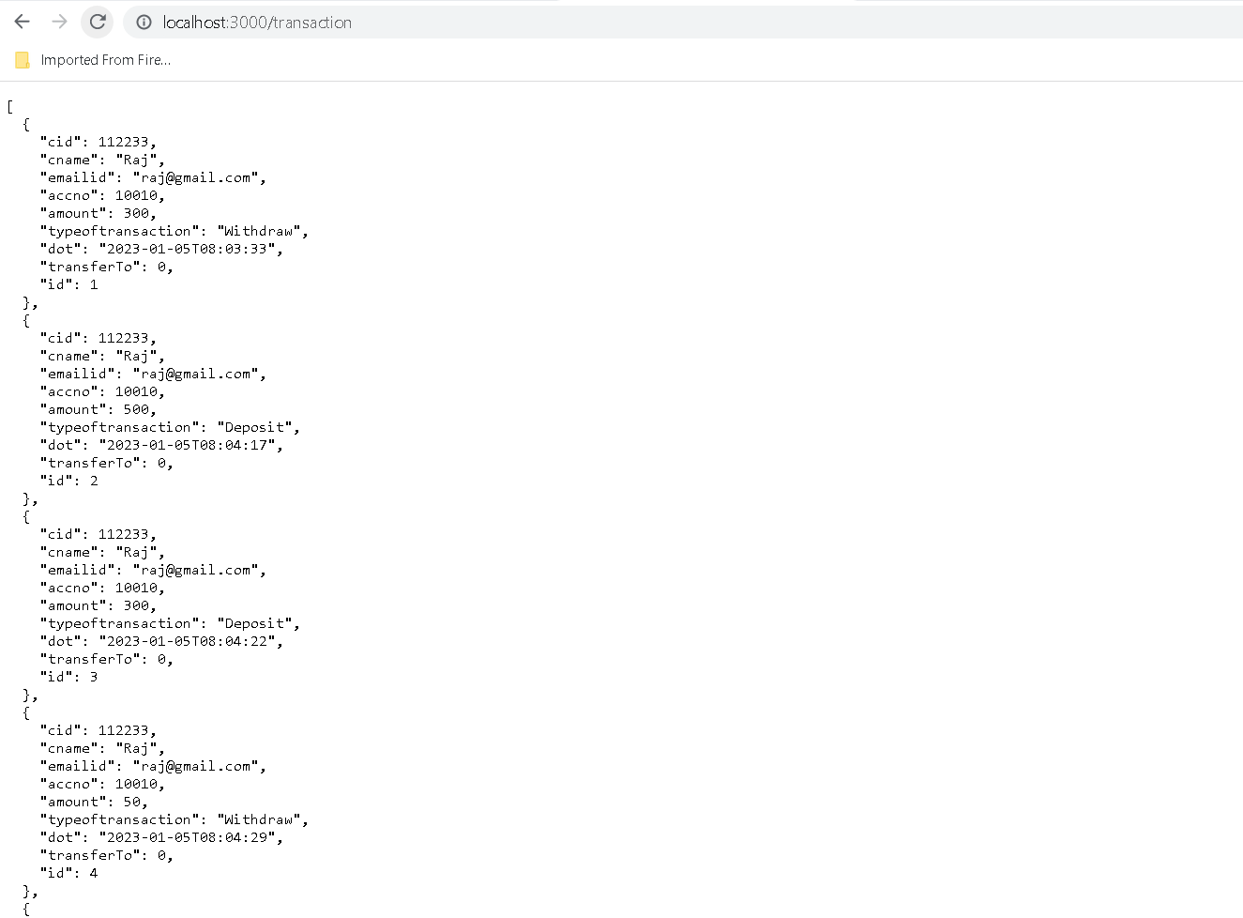
All transaction details stored in json file

Slide 24
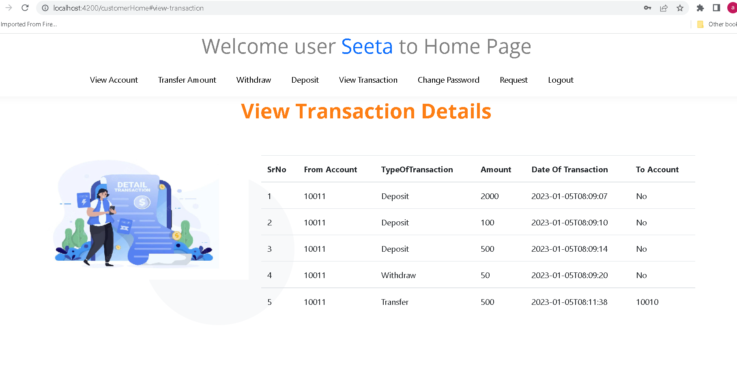
To check its own transaction details

Slide 25
Now we do the login using admin
username : admin@gmail.com
password : admin@123

Slide 26
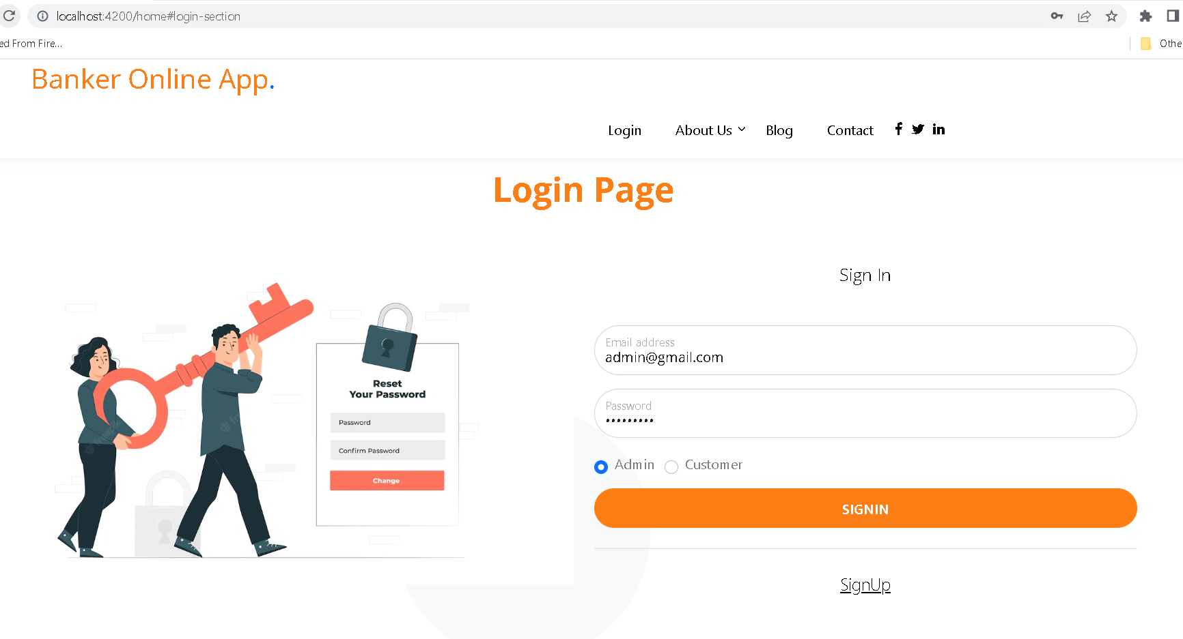

Slide 27
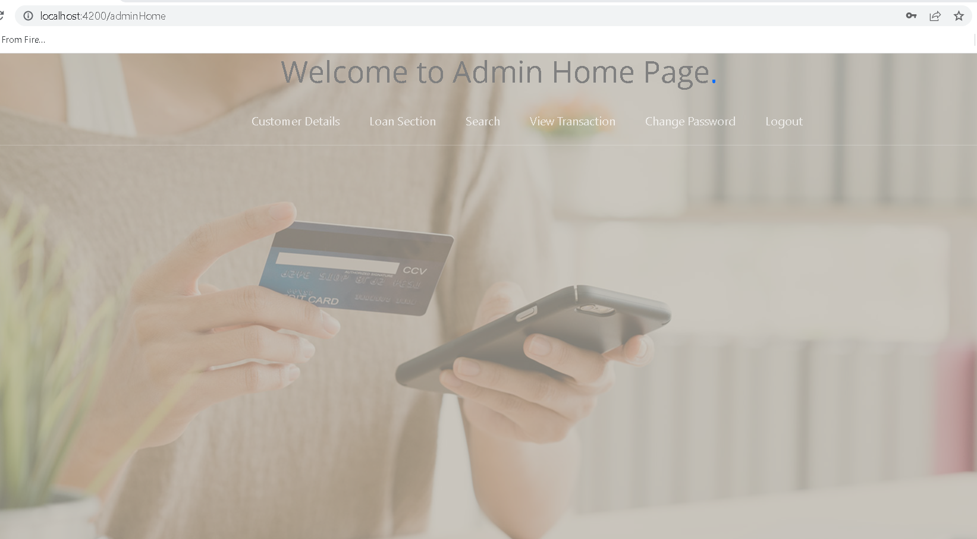
Admin dashboard

Slide 28
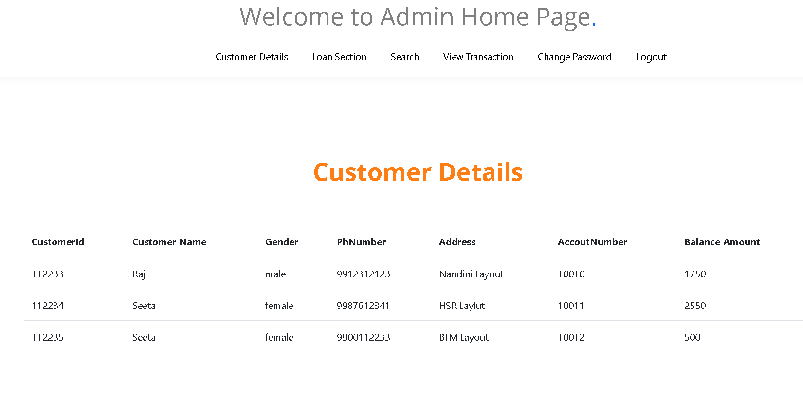
View all customer details

Slide 29
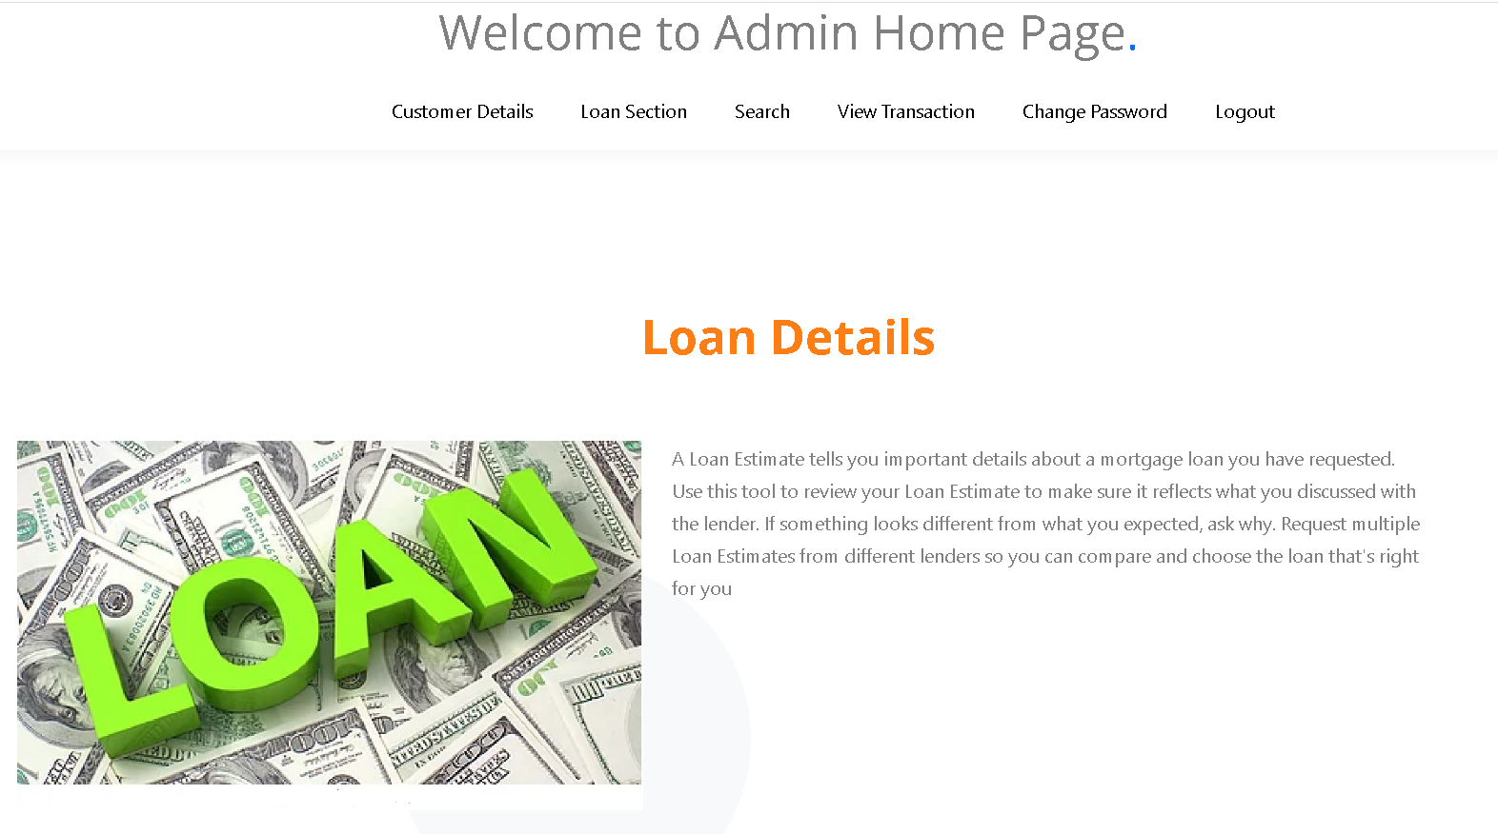
Loan section - static web page

Slide 30
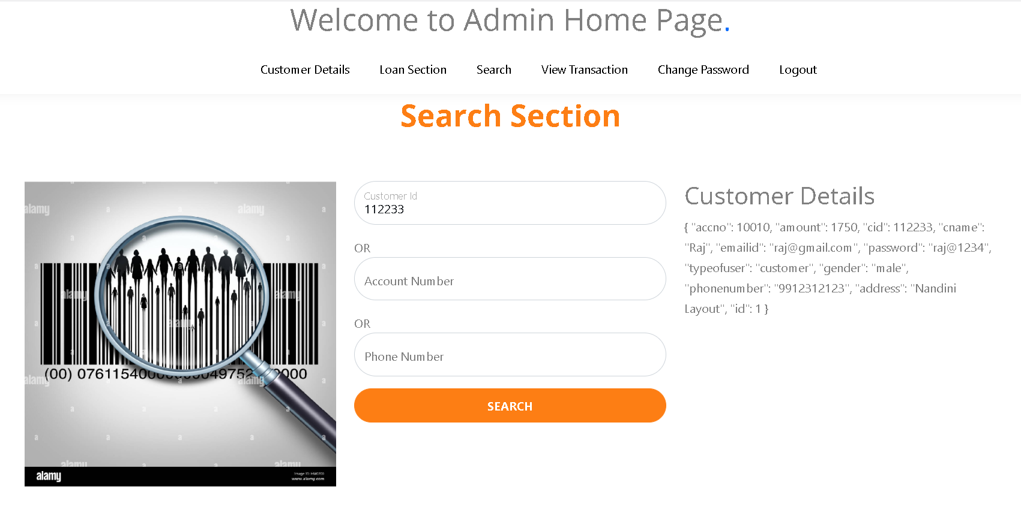
Search customer
By : customer id

Slide 31
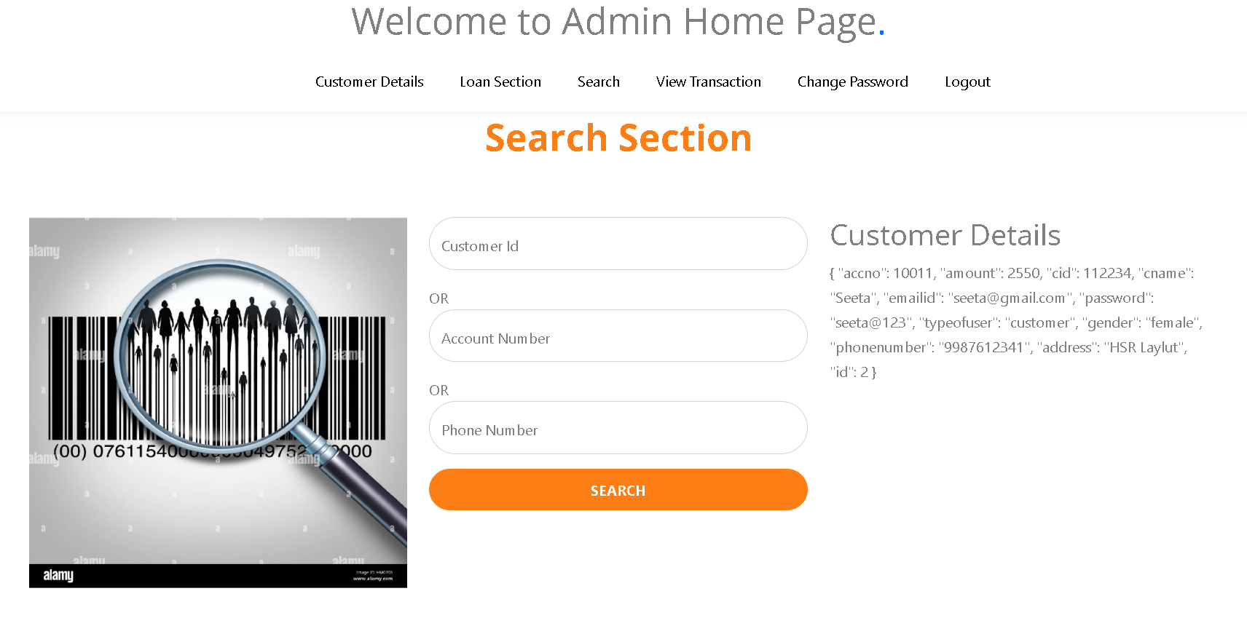
Search customer
By account number

Slide 32
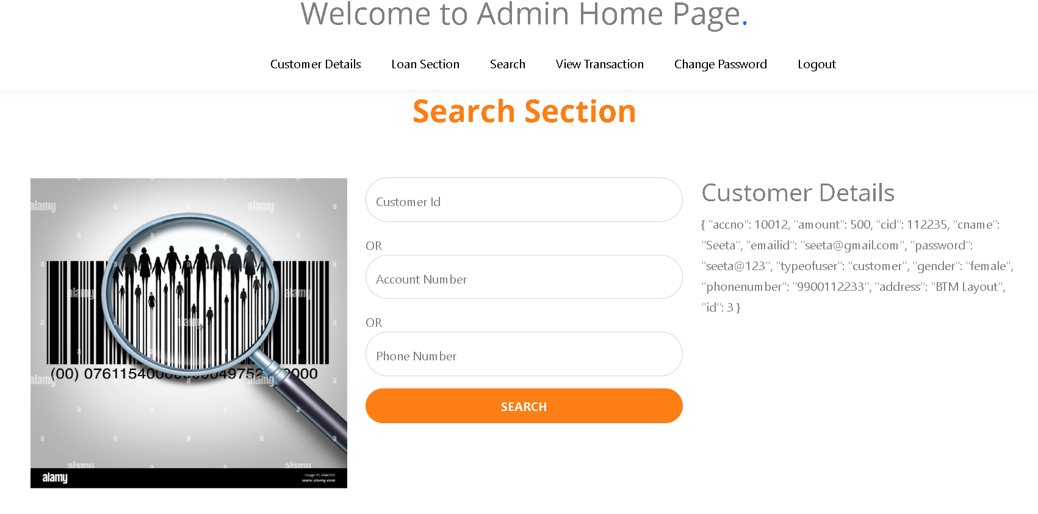
Search customer
By phone number

Slide 33
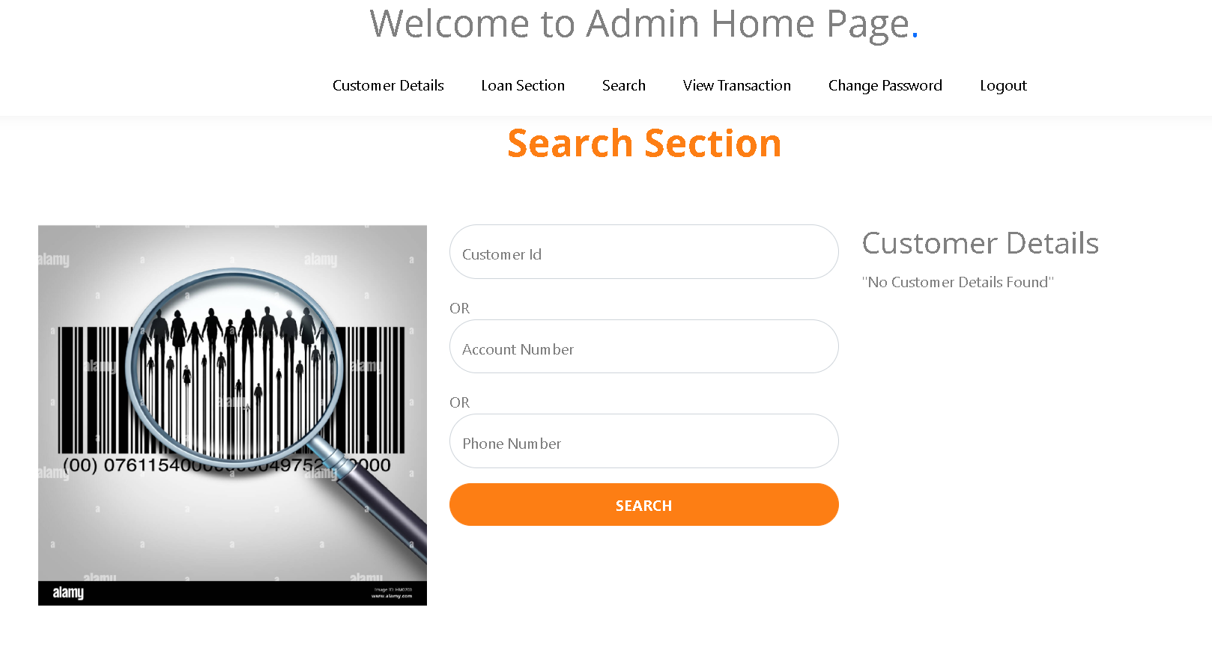
Search customer – not available

Slide 34
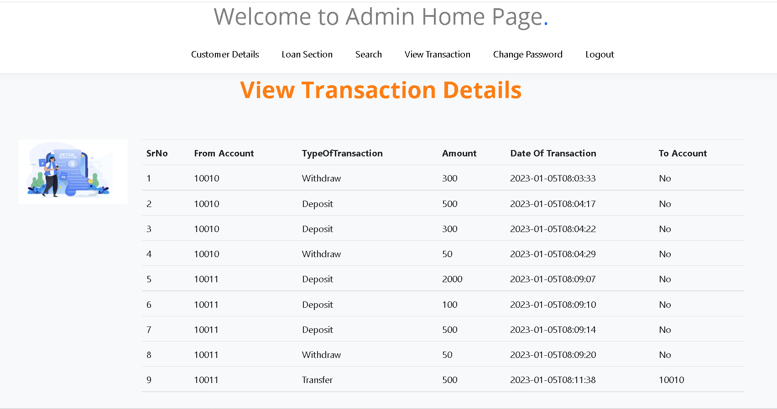
View all customer details

Slide 35
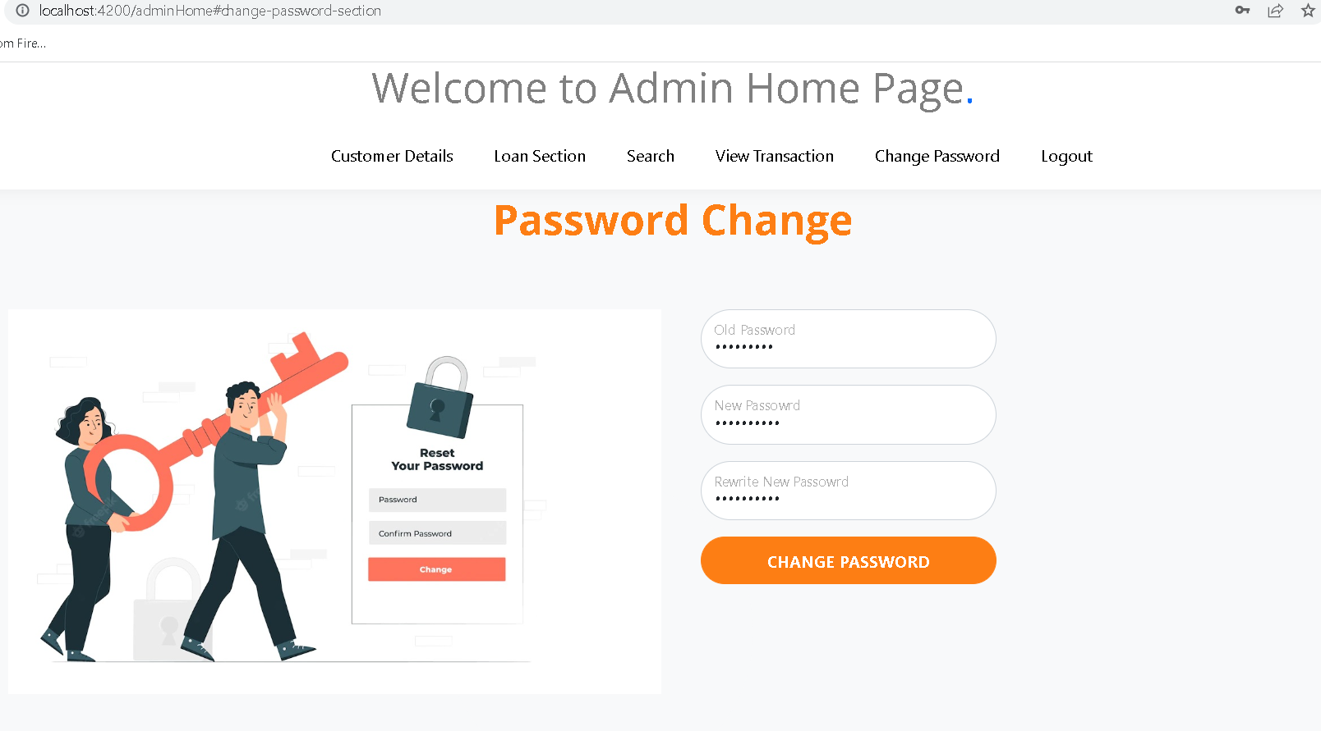
Change password

